Slide 1
XSS Prevention

Slide 2
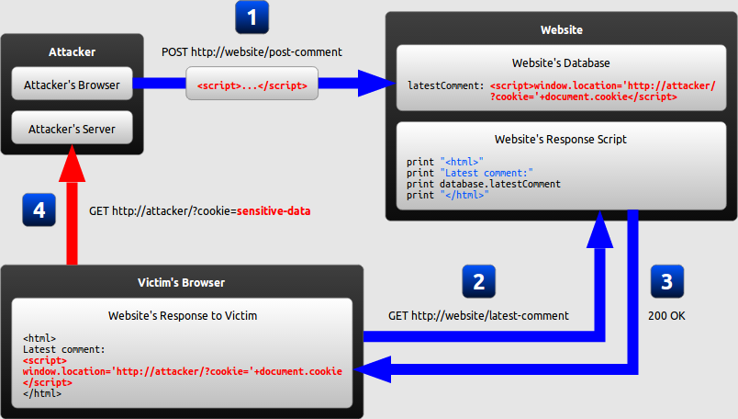
Persistent/Stored XSS
You enter data which is stored within the application and then returned later on, in response to another request. This data contains JavaScript code which is executed in the context of the application.
Notes:
The attacker uses one of the website's forms to insert a malicious string into the website's database.
The victim requests a page from the website.
The website includes the malicious string from the database in the response and sends it to the victim.
The victim's browser executes the malicious script inside the response, sending the victim's cookies to the attacker's

Slide 3
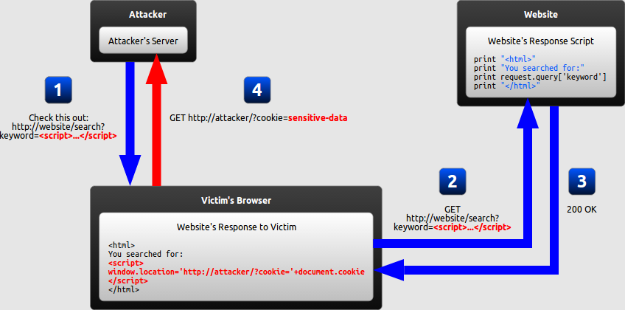
Reflected XSS
You enter data to the application which is then echoed back without escaping, sanitization or encoding and it is possible to include JavaScript code which is then executed in the context of the application.
Notes:
The attacker crafts a URL containing a malicious string and sends it to the victim.
The victim is tricked by the attacker into requesting the URL from the website.
The website includes the malicious string from the URL in the response.
The victim's browser executes the malicious script inside the response, sending the victim's cookies to the attacker's

Slide 4
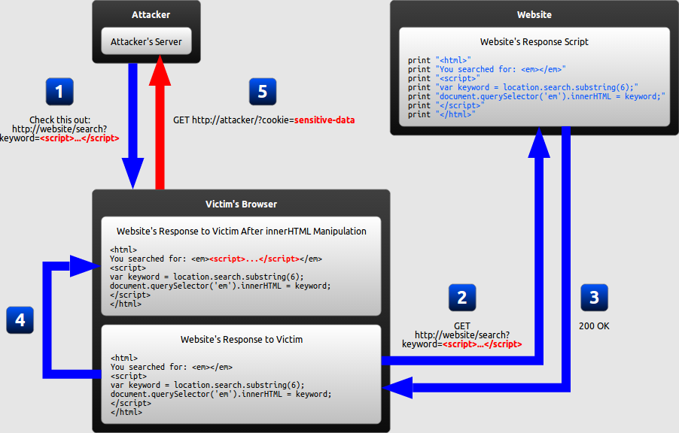
DOM-based XSS
You enter data, which modifies the DOM of the web page and insert it in the context of the webpage. It is similar to reflected XSS but the difference is that in modifying the DOM the data may not ever get to the server. → server-side filters might not be effective.
Notes:
The attacker crafts a URL containing a malicious string and sends it to the victim.
The victim is tricked by the attacker into requesting the URL from the website.
The website receives the request, but does not include the malicious string in the response.
The victim's browser executes the legitimate script inside the response, causing the malicious script to be inserted into the page.
The victim's browser executes the malicious script inserted into the page, sending the victim's cookies to the attacker's server.

Slide 5
Outline
Factors affecting prevention techniques
Context
Inbound/Outbound
Client/Server
Encoding
Client-Side VS Server-Side
Limitations
Validation
Blacklisting VS Whitelisting
Content Security Policy

Slide 6
Preventing XSS
Secure input handling is needed:
Encoding: escapes the user input so that the browser interprets it only as data and not as code.
Validation: filters user input so that the browser interprets it as code without malicious commands.

Slide 7
Factors affecting Encoding/Validation
Context:
Secure input handling needs to be performed differently depending on where in a page the user input is inserted.
Inbound/outbound:
Secure input handling can be performed either when your website receives the input (inbound) or right before your website inserts the input into a page (outbound)
Client/server:
Secure input handling can be performed either on the client-side or on the server-side, both of which are needed in different circumstances
Notes:
Encoding and Validation depend on the same factors.
Before explaining in detail how encoding and validation work, we will describe each of these points.

Slide 8
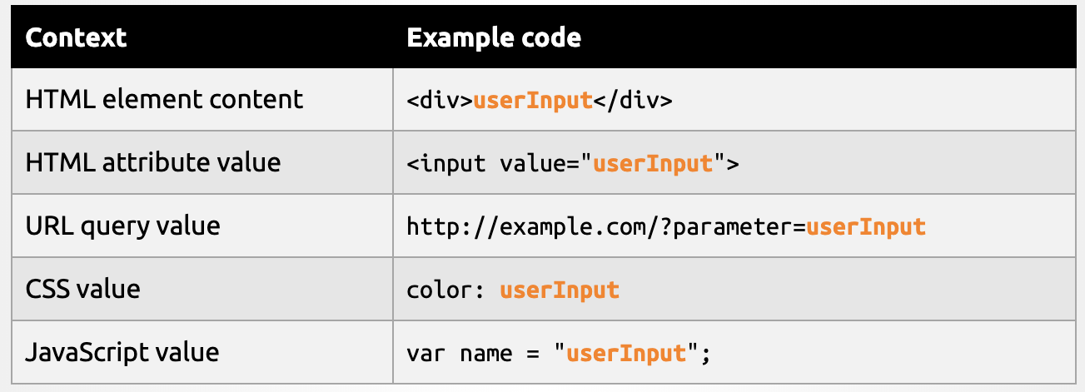
Why Context Matters (1/2)
There are different points where the user input can be placed in a web page:

Slide 9
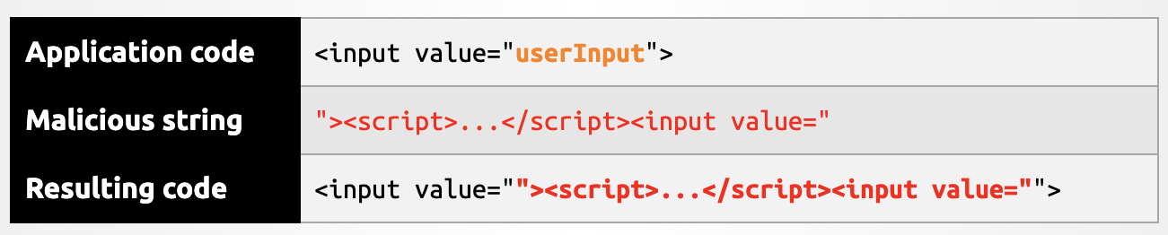
Why Context Matters (2/2)
Secure input handling will always have to be tailored to the context where the user input will be inserted.
This could be prevented by simply removing all quotation marks in the user input, and everything would be fine – but only in this context.
If the same input were inserted into another context, the closing delimiter would be different and injection would become possible.

Slide 10
Inbound/Outbound Input Handling
Instinctively, it might seem that XSS can be prevented by encoding or validating all user input as soon as your website receives it.
Notes:
URL shortening services can mask the malicious string from users who might otherwise identify it.

Slide 11
Inbound/Outbound Input Handling
Instinctively, it might seem that XSS can be prevented by encoding or validating all user input as soon as your website receives it.
…However the input can be inserted into several contexts in a page.
There is no easy way of determining when user input arrives which context it will eventually be inserted into.
The same user input needs to be inserted into different contexts.
Outbound input handling can take into account the specific context that user input will be inserted into.
Notes:
URL shortening services can mask the malicious string from users who might otherwise identify it.

Slide 12
Where to Perform Secure Input Handling
Server-side code: Persistent (or Storage) XSS
Reflective XSS
This is done in the language supported by the server
Client-side code: DOM-Based XSS
This is done in JavaScript

Slide 13
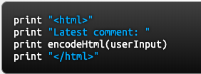
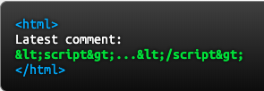
Encoding
Escaping the user input so that the browser interprets it only as data not as code
Best example is HTML encoding: ‘<‘ → &lt; or ‘>’ → &gt;
For Example:
If the user input were the string <script>...</script>, the resulting HTML would be as follows:
Notes:
Because all characters with special meaning have been escaped, the browser will not parse any part of the user input as HTML

Slide 14
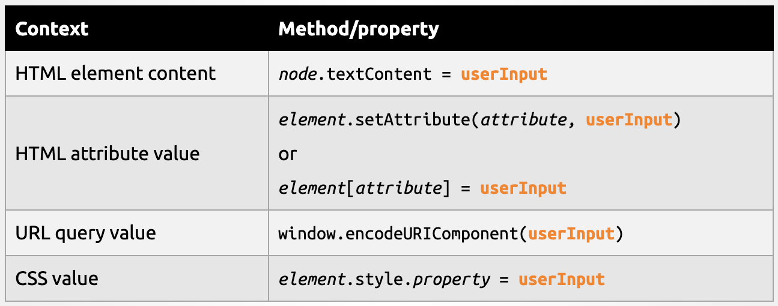
Encoding in client-side code
Client-side code: JavaScript language has built-in methods and properties that automatically encode all data in a context-aware manner.

Slide 15
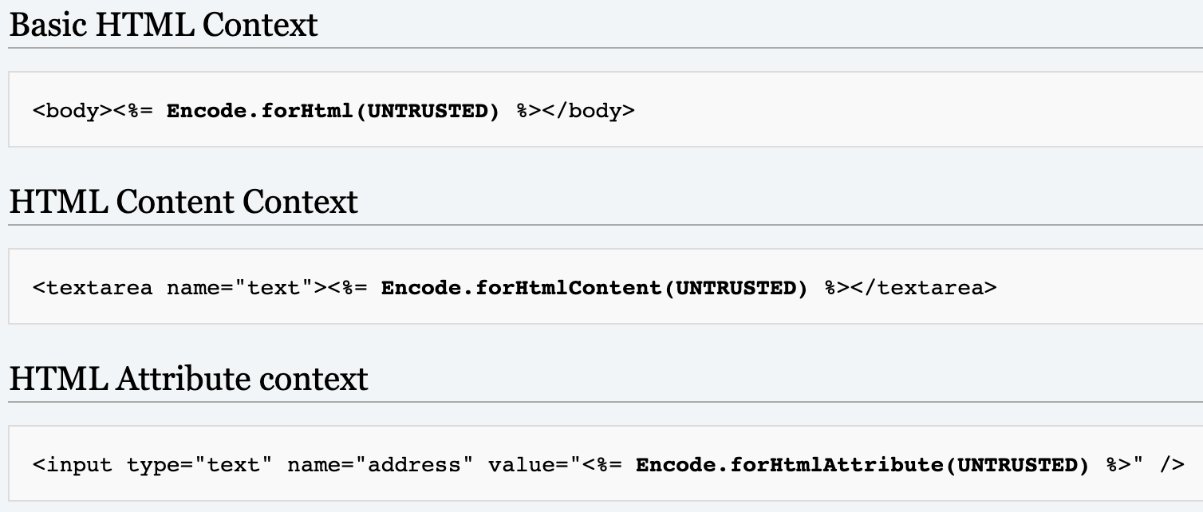
Encoding in client-side code using the Java Encoder Project
https://www.owasp.org/index.php/OWASP_Java_Encoder_Project#tab=Main

Slide 16
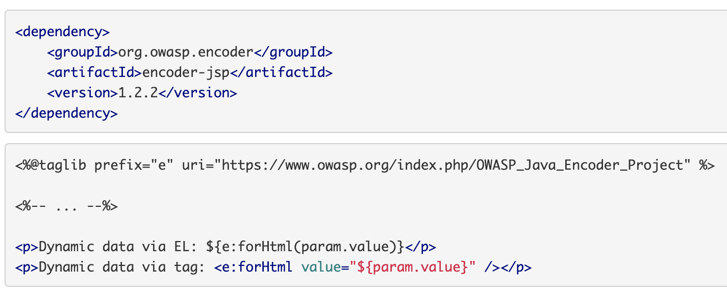
Encoding in client-side code using the Java Encoder Project
http://owasp.github.io/owasp-java-encoder/

Slide 17
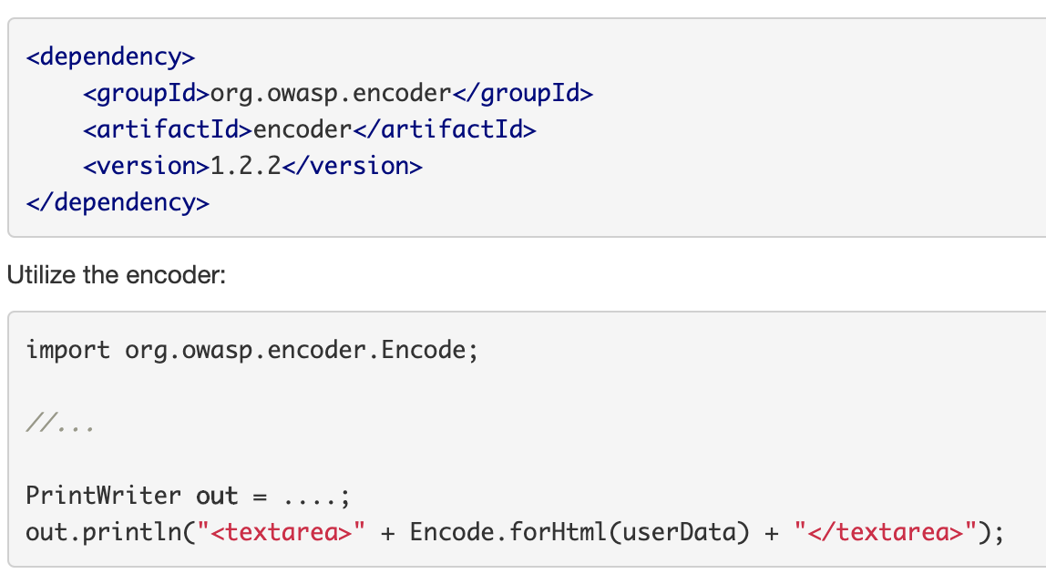
Encoding in server-side code using the Java Encoder Project
Server-side code: you rely on the functions available in your server-side language or framework
http://owasp.github.io/owasp-java-encoder/
Notes:
URL shortening services can mask the malicious string from users who might otherwise identify it.

Slide 18
Limitations of Encoding
Instinctively, it might seem that XSS can be prevented by encoding or validating all user input as soon as your website receives it.
…However the input can be inserted into several contexts in a page.
There is no easy way of determining when user input arrives which context it will eventually be inserted into.
The same user input needs to be inserted into different context.
Outbound input handling can take into account the specific context that user input will be inserted into.

Slide 19

Limitations of Encoding
It will still be possible to input malicious strings in certain contexts
This does not prevent the attacker from inserting a URL beginning with “javascript:”. When the link is clicked, whatever JavaScript is embedded inside the URL will be executed
Encoding is inadequate when you want the user to customize part of the HTML page. An example is a user profile page where the user can define custom HTML which supposedly you don’t want to encode.
In such situations encoding needs to be complemented with validation.

Slide 20
Validation
Filtering user input so that all malicious parts of it are removed, without necessarily removing all code in it.
For example, remove some HTML elements (such as <em> and <strong>) but disallowing others (such as <script>)
Characteristics:
Classification strategy: User input can be classified using either blacklisting or whitelisting.
Validation outcome: User input identified as malicious can either be rejected or sanitized.
Notes:
URL shortening services can mask the malicious string from users who might otherwise identify it.

Slide 21

Blacklisting
Defining forbidden patterns that should not appear in user input. If a string matches this pattern, it is then marked as invalid.
Example: allow users to submit custom URLs with any protocol except javascript:
Drawbacks:
Complexity: Describing malicious string is a complex task!
Looking for javascript: also implies looking for Javascript: and &#106:avascript:
Notes:
URL shortening services can mask the malicious string from users who might otherwise identify it.

Slide 22
Blacklisting
Defining forbidden patterns that should not appear in user input. If a string matches this pattern, it is then marked as invalid.
Example: allow users to submit custom URLs with any protocol except javascript:
Drawbacks:
Staleness: Even a perfect blacklist would fail if a new feature allowing malicious use wasadded to the browser.
onmousewheel was introduced only with HTML5
→ Blacklisting is strongly discouraged
Notes:
This drawback is especially significant in web development, which is made up of many different technologies that are constantly being updated.

Slide 23

Whitelisting
Defines an allowed pattern and marks input as invalid if it does not match this pattern
For example, it is possible to allow users to submit custom URLs containing only the protocols http: and https:
Benefits
Simplicity: Accurately describing a set of safe strings is generally much easier than identifying the set of all malicious strings
Longevity: A whitelist will generally not become obsolete when a new feature is added to the browser.
Notes:
For example, an HTML validation whitelist allowing only the title attribute on HTML elements would remain safe even if it was developed before the intriduction of HTML5 onmousewheel attribute

Slide 24
Validation Outcome
When input has been marked as invalid you can
Reject the input, preventing it from being used elsewhere
Sanitize: all invalid parts of the input are removed and the remaining input is used normally
Characteristics:
Rejection is the easiest approach to implement
Sanitization allows a broader range of inputs from the user.
Don’t use blacklisting to perform sanitization.

Slide 25
Which Prevention Technique?
Encoding combined with validation
As a first line of defense perform outbound encoding and validation
As a second line of defense, perform inbound validation to sanitize or reject data that is clearly invalid.
… As a third line of defense, use Content Security Policy (CSP)

Slide 26
Content Security Policy (CSP)
CSP forces the browser viewing your page to only use resources downloaded from trusted sources
Resource: script, stylesheet, image, or some other type of file referred to by the page.
The following rules can be enforced
No untrusted sources: External resources can only be loaded from a set of clearly defined trusted sources
No inline resources: Inline JavaScript and CSS will not be evaluated
No eval: The JavaScript code represented as a string cannot be executed
Notes:
URL shortening services can mask the malicious string from users who might otherwise identify it.

Slide 27
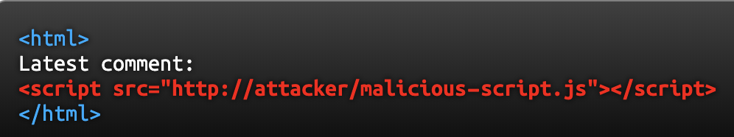
CSP in Action
With a CSP policy defined properly, the browser would not load and execute malicious-script.js because http://attacker/ would not be in the set of trusted sources
This would be valid even if the attacker injects the script code inline, because CSP can disallow inline JavaScript
Notes:
URL shortening services can mask the malicious string from users who might otherwise identify it.

Slide 28
How to enable CSP
Your webpage must be served with an additional HTTP header: Content-Security-Policy.
This policy can be set on a page-by-page basis or to the entire website
The value of Content-Security-Policy header is a string defining one or more security policies
Notes:
URL shortening services can mask the malicious string from users who might otherwise identify it.

Slide 29
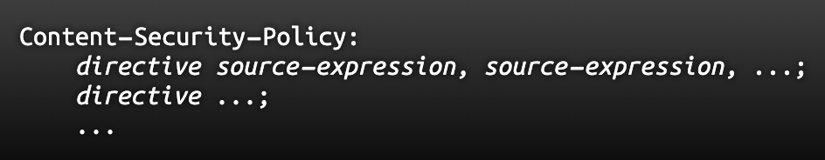
Syntax of CSP
Directives: strings specifying a type of resource, taken from a predefined list
Source expressions: patterns describing one or more servers that resources can be downloaded from.
Notes:
URL shortening services can mask the malicious string from users who might otherwise identify it.

Slide 30
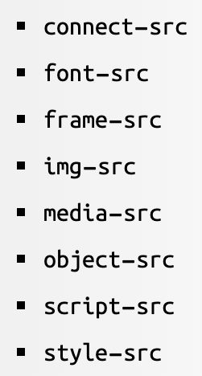
Directives
default-src can be used to provide a default value for all directives that have not been included in the header.
Notes:
URL shortening services can mask the malicious string from users who might otherwise identify it.

Slide 31
Source Expressions
protocol://host-name:port-number
OR
none: allows no resources
self: allows resources from the host that served the page
unsafe-inline: allows resources embedded in the page, such as inline <script> elements, <style> elements, and javascript: URL
unsafe-eval: allows the use of the JavaScript eval function
Notes:
URL shortening services can mask the malicious string from users who might otherwise identify it.

Slide 32
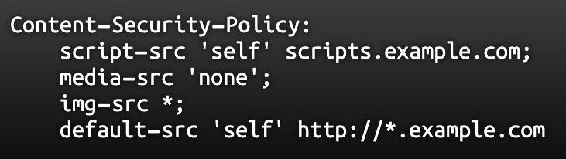
Example Policy
Scripts can be downloaded from the host serving the page and from scripts.example.com
Audio and video files cannot be downloaded from anywhere
Image files can be downloaded from any host
All other resources can be downloaded only from the host serving the page and from any subdomain of example.com
Notes:
URL shortening services can mask the malicious string from users who might otherwise identify it.

Slide 33
Example Policy
protocol://host-name:port-number
OR
none: allows no resources
self: allows resources from the host that served the page
unsafe-inline: allows resources embedded in the page, such as inline <script> elements, <style> elements, and javascript: URL
unsafe-eval: allows the use of the JavaScript eval function
https://content-security-policy.com/
Notes:
URL shortening services can mask the malicious string from users who might otherwise identify it.

Slide 34
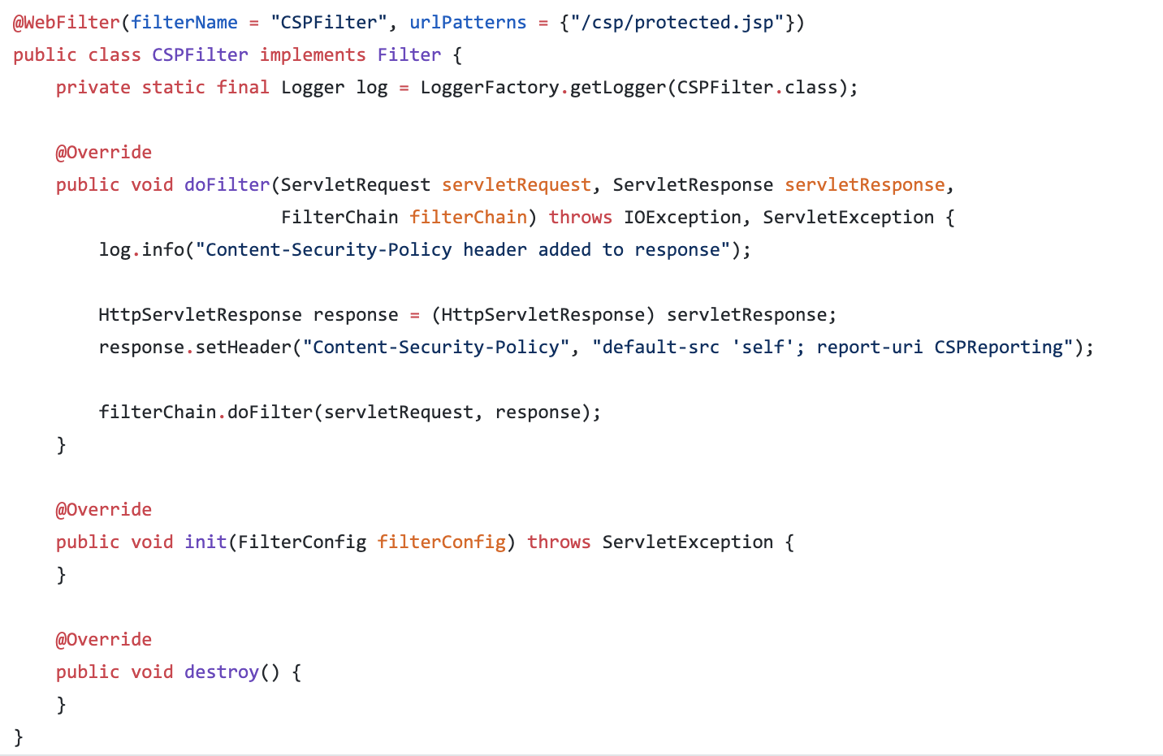
Implement CSP in your WebApp
Notes:
URL shortening services can mask the malicious string from users who might otherwise identify it.

Slide 35
Broken Access Control Prevention

Slide 36
Define an Access Control Policy
Elicit the assets you want to protect
For each asset define who is entitled to access it
Types of access control policies:
Role based access control policy
Discretionary Access Control (DAC)
MAC access control
Permission based access control
https://github.com/OWASP/CheatSheetSeries/blob/master/cheatsheets/Access_Control_Cheat_Sheet.md

Slide 37
Assignment 2 - Structure
Intro: how did you work collaboratively
A1-A5, A7 (Only the vulnerabilities we have seen)
Criticality
Process you adopt to identify the vulnerability
Where is the vulnerability located
How the vulnerability can be exploited
If a vulnerability is not present justify why

